Slide 1

Flutter – JSON Serialization

Slide 2


Serialization (In general)
Process of converting an object into a stream of bytes to store the object or transmit it to memory, a database, or a file.
Purpose - Save the state of an object in order to be able to recreate it when needed.
The reverse process is called deserialization.

Slide 3


Which JSON serialization method is right for me?
Manual Serialization
Automated serialization using code generation

Slide 4




Manual Serialization
manual_serialization.dart
Using the built-in JSON decoder in dart:convert.
jsonDecode() function resulting Map<String, dynamic>.
For smaller projects.
{ "name": "John Smith", "email": "john@example.com", "address": { "street": "My st.", "city": "New York" } }
void parseJsonManually(String jsonString) { Map<String, dynamic> user = jsonDecode(jsonString); type = "Manually Parsed: "; userName = 'Howdy, ${user['name']}'; email = 'We sent the verification link to ${user['email']}.'; address = '${user['address']['street']}, ${user['address']['city']}'; setState(() {}); }

Slide 5

Serializing JSON inside model class.
manual_serialization.dart
{ "name": "John Smith", "email": "john@example.com", "address": { "street": "My st.", "city": "New York" } }
class User { final String name; final String email; User(this.name, this.email); User.fromModelJson(Map<String, dynamic> json) : name = json['name'], email = json['email']; Map<String, dynamic> toModelJson() => { 'name': name, 'email': email, }; } void parseJsonUsingModel(String jsonString) { User user = User.fromModelJson(jsonDecode(jsonString)); type = "Parsed using Model: "; userName = 'Howdy, ${user.name}'; email = 'We sent the verification link to ${user.email}.'; address = '${user.address.street}, ${user.address.city}'; setState(() {}); }
Using fromJson() constructor, to create a new instance
Using toJson() to convert model into map.

Slide 6

Automated serialization using code generation
Include packages:
json_serializable
json_annontation
build_runner
pubspec.yaml
dependencies: # regular dependencies here json_annotation: ^4.0.1 dev_dependencies: # other dev_dependencies here build_runner: ^2.0.5 json_serializable: ^4.1.3

Slide 7


user.dart
Creating model classes, the json_serializable way
import 'package:json_annotation/json_annotation.dart'; import 'package:json_serialization_example/models/address.dart'; part 'user.g.dart'; @JsonSerializable(explicitToJson: true) class User { final String name, email; Address address; User({ required this.name, required this.email, required this.address, }); /// Created For Automated Json Serialization factory User.fromJson(Map<String, dynamic> data) => _$UserFromJson(data); Map<String, dynamic> toJson() => _$UserToJson(this); }
One-time code generation using command flutter pub run build_runner build
Creates part(extension) files.
Automatically generates _$UserFromJson() and _$UserToJson() functions.
Using annotations which makes our lives easier.
explicitToJson: true in case there is another model existing inside the model. E.g., Address model inside User model.
Does the same for address model.
user.g..dart
// GENERATED CODE - DO NOT MODIFY BY HAND part of 'user.dart’;
// JsonSerializableGenerator User _$UserFromJson(Map<String, dynamic> json) { return User( name: json['name'] as String, email: json['email'] as String, address: Address.fromJson(json['address'] as Map<String, dynamic>), ); } Map<String, dynamic> _$UserToJson(User instance) => <String, dynamic>{ 'name': instance.name, 'email': instance.email, 'address': instance.address.toJson(), };

Slide 8

Automated Serialization
automated_serialization.dart
Using the automatic generated class model.g.dart.
Model.fromJson() function resulting Model class.
For larger projects.
{ "name": "John Smith", "email": "john@example.com", "address": { "street": "My st.", "city": "New York" } }
void parseJson(String jsonString) { User user = User.fromJson(jsonDecode(jsonString)); type = "Parse Json: "; userName = 'Howdy, ${user.name}'; email = 'We sent the verification link to ${user.email}.'; address = '${user.address.street}, ${user.address.city}'; setState(() {}); }

Slide 9
For Generic Classes
generic_serialization.dart
@JsonSerializable(createToJson: false) class BaseResponse<T> { final int? status; final String? msg; @JsonKey(fromJson: _dataFromJson) final T? data; const BaseResponse({ this.status, this.msg, this.data, }); factory BaseResponse.fromJson(Map<String, dynamic> json) => _$BaseResponseFromJson(json); /// Decodes [json] by "inspecting" its contents. static T _dataFromJson<T>(Object json) { if (json is Map<String, dynamic>) { if (json.containsKey('email')) { return User.fromJson(json) as T; } if (json.containsKey('title')) { return Article.fromJson(json) as T; } } else if (json is List) { // NOTE: this logic assumes the ONLY valid value for a `List` in this case // is a List<Author>. If that assumption changes, then it will be // necessary to "peek" into non-empty lists to determine the type! return json .map((e) => Article.fromJson(e as Map<String, dynamic>)) .toList() as T; } throw ArgumentError.value( json, 'json', 'Cannot convert the provided data.', ); } }
Using the automatic generated class model.g.dart.
_dataFromJson() function resulting Model class.

Slide 10

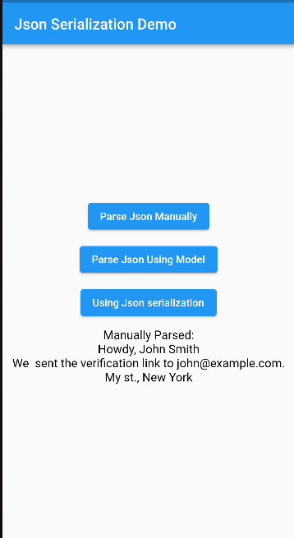

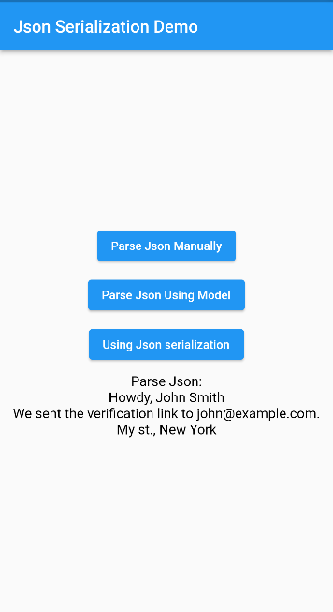

Working Outputs
Manually Parsed
Manually Parsed
Using Model
Automated Parsing

Slide 11
THANK YOU ANY QUERIES?

